Slide 1
HILL CLIMBING SEARCH

Slide 2
WHAT IS HILL CLIMBING SEARCH
Hill climbing algorithm is a local search algorithm which continuously moves in the direction of increasing elevation/value to find the peak of the mountain or best solution to the problem. It terminates when it reaches a peak value where no neighbor has a higher value. Hill climbing algorithm is a technique which is used for optimizing the mathematical problems.
One of the widely discussed examples of Hill climbing algorithm is Traveling-salesman Problem in which we need to minimize the distance traveled by the salesman.

Slide 3
FEATURES OF HILL CLIMBING:
Greedy approach: Hill-climbing algorithm search moves in the direction which optimizes the cost.
No backtracking: It does not backtrack the search space, as it does not remember the previous states.
Generate and Test variant: Hill Climbing is the variant of Generate and Test method. The Generate and Test method produce feedback which helps to decide which direction to move in the search space.
Local Search:

Slide 4
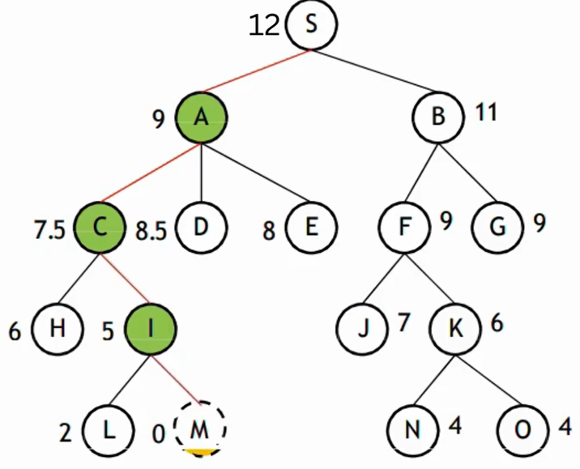
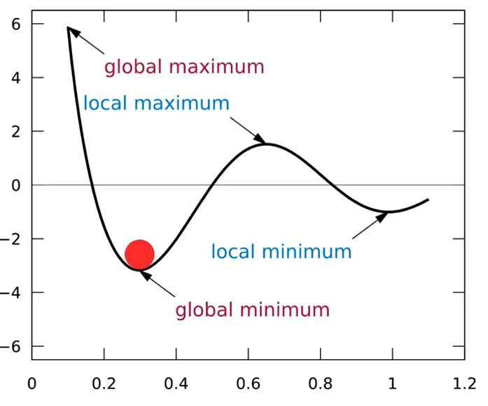
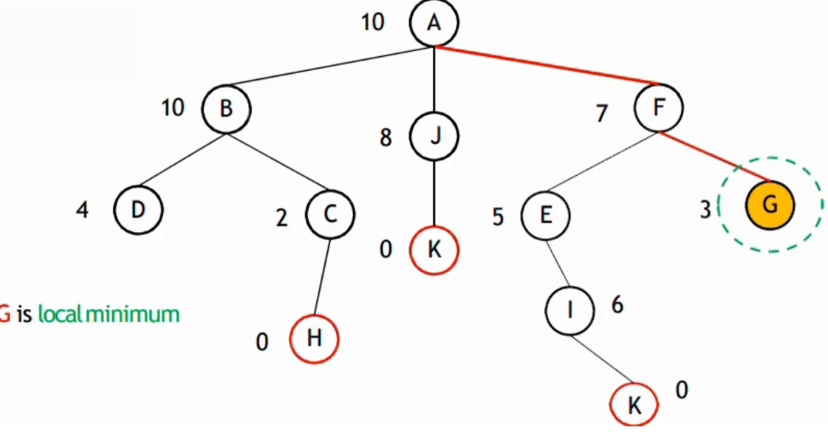
FEATURES OF HILL CLIMBING

Slide 5
TYPES OF HILL CLIMBING
Simple Hill climbing: It examines the neighboring nodes one by one and selects the first neighboring node which optimizes the current cost as the next node.
Steepest-Ascent Hill climbing: It first examines all the neighboring nodes and then selects the node closest to the solution state as of the next node.
Stochastic hill climbing: It does not examine all the neighboring nodes before deciding which node to select. It just selects a neighboring node at random and decides (based on the amount of improvement in that neighbor) whether to move to that neighbor or to examine another.

Slide 6
ALGORITHM FOR SIMPLE HILL CLIMBING
Pseudocode
1. Start with an initial state (current_state).
2. Loop until a stopping condition is met:
a) Evaluate the current_state.
b) Generate a successor (neighbor) of the current_state.
c) If the successor is better than current_state:
Move to the successor (current_state = successor).
Else:
Stop and return current_state (local maximum reached).
3. End.

Slide 7
ALGORITHM FOR SIMPLE HILL CLIMBING
Stopping Conditions
No better neighbor exists (local maximum/plateau).
Goal state is reached.
Predefined number of steps/iterations completed.
Characteristics of Simple Hill-Climbing
Greedy approach → immediately accepts the first better neighbor it finds.
Does not compare all neighbors (unlike steepest-ascent).
Very fast, but can get stuck in:
Local maxima
Plateaus
Ridges

Slide 8
ALGORITHM FOR STEEPEST-ASCENT HILL CLIMBING
Stopping Conditions
No neighbor is better than the current state (local maximum/plateau).
Goal state is reached.
Predefined number of iterations completed.
Characteristics
Checks all neighbors and picks the best one (unlike Simple Hill Climbing which picks the first better one).
More thorough, less likely to stop early.
But more computationally expensive (since all neighbors must be evaluated).

Slide 9
Quick Comparison
Feature | Simple Hill Climbing | Steepest-Ascent Hill Climbing
Neighbor selection | First better neighbor | Best among all neighbors
Speed | Faster | Slower (checks all)
Risk of local maxima | Higher | Lower (but still possible)
Computation | Low | Higher

Slide 10
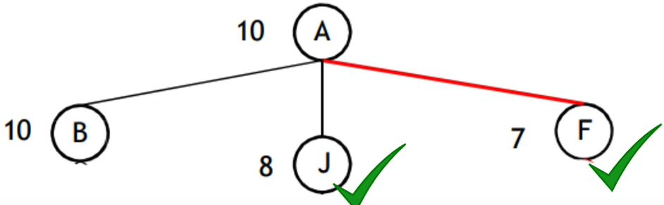
ALGORITHM FOR STOCHASTIC HILL CLIMBING

Slide 11
ALGORITHM FOR STOCHASTIC HILL CLIMBING
Unlike Simple or Steepest-Ascent, this variant chooses randomly among better neighbors instead of always picking the first or the best.
This randomness helps the search escape plateaus and ridges.
Pseudocode
1. Start with an initial state (current_state).
2. Loop until a stopping condition is met:
a) Evaluate the current_state.
b) Generate all successors (neighbors) of current_state.
c) From the set of neighbors that are better than current_state:
Randomly select one neighbor.
d) If such a neighbor exists:
Move to that neighbor (current_state = selected_neighbor).
Else:
Stop and return current_state (local maximum reached).
3. End.

Slide 12
ALGORITHM FOR STOCHASTIC HILL CLIMBING
Stopping Conditions
No better neighbor exists.
Goal state reached.
Maximum number of iterations.
Characteristics
Uses randomness in selecting neighbors.
Less greedy → can explore more than simple hill climbing.
Still local search (keeps only the current state).
Can still get stuck in local maxima, but less than simple hill climbing.

Slide 13
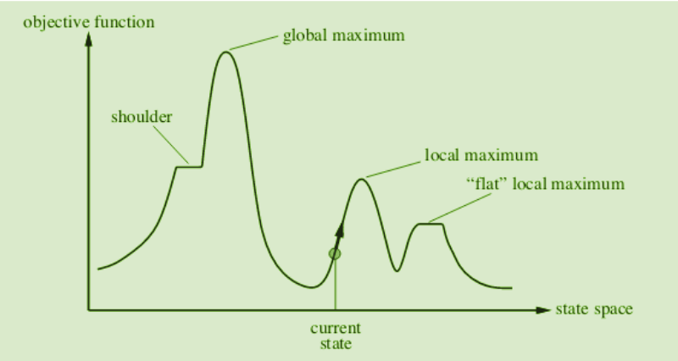
STATE SPACE DIAGRAM FOR HILL CLIMBING
A state space is a landscape or a region which describes the relation between cost function and various algorithms.
X-axis: denotes the state space ie states or configuration our algorithm may reach.
Y-axis: denotes the values of objective function corresponding to a particular state.

Slide 14
DIFFERENT REGIONS IN THE STATE SPACE DIAGRAM:
A state-space diagram consists of various regions that can be explained as follows;
Local maximum: A local maximum is a solution that surpasses other neighboring solutions or states but is not the best possible solution.
Global maximum: This is the best possible solution achieved by the algorithm.
Current state: This is the existing or present state.
Flat local maximum: This is a flat region where the neighboring solutions attain the same value.
Shoulder: This is a plateau whose edge is stretching upwards.

Slide 15
PROBLEMS WITH HILL CLIMBING
There are three regions in which a hill-climbing algorithm cannot attain a global maximum or the optimal solution: local maximum, ridge, and plateau.
Local maximum: At a local maximum all neighboring states have a value that is worse than the current state. Since hill-climbing uses a greedy approach, it will not move to the worse state and terminate itself. The process will end even though a better solution may exist.
Plateau: On the plateau, all neighbors have the same value. Hence, it is not possible to select the best direction.
Ridge: Any point on a ridge can look like a peak because movement in all possible directions is downward. Hence the algorithm stops when it reaches this state.

Slide 16
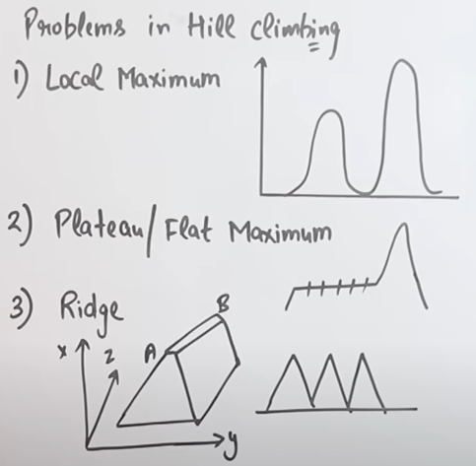
PROBLEMS WITH HILL CLIMBING

Slide 17
OVERCOMING THE PROBLEMS WITH HILL CLIMBING
To overcome the local maximum problem: Utilize the backtracking technique. Maintain a list of visited states. If the search reaches an undesirable state, it can backtrack to the previous configuration and explore a new path.
To overcome plateaus: Make a big jump. Randomly select a state far away from the current state. Chances are that we will land in a non-plateau region.
To overcome Ridge: In this kind of obstacle, use two or more rules before testing. It implies moving in several directions at once.

Slide 18
APPLICATIONS OF HILL CLIMBING ALGORITHM
Marketing: A hill-climbing algorithm can help a marketing manager to develop the best marketing plans. This algorithm is widely used in solving Traveling-Salesman problems.
Robotics: Hill climbing is useful in the effective operation of robotics. It enhances the coordination of different systems and components in robots.
Job Scheduling: Job scheduling is achieved through the migration of jobs from one node to a neighboring node. A hill-climbing technique helps establish the right migration route.

Slide 19
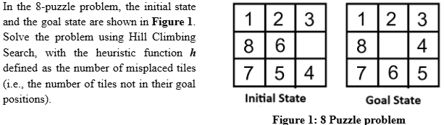
Example

Slide 20
Example
Goal layout (for reference)
1 2 3
8 _ 4
7 6 5
Initial state (blank = _)
1 2 3
8 6 _
7 5 4
Compute h = number of tiles not in their goal positions (ignore blank).
Tiles out of place: 6, 5, 4 → initial h=3.
Neighbors of the initial state (blank at (2,3))
Move Up (swap blank with 3) → 1 2 _
8 6 3
7 5 4
Misplaced tiles: 3,6,5,4 → h=4.

Slide 21
Example
Move Left (swap blank with 6) → 1 2 3
8 _ 6
7 5 4
Misplaced tiles: 6,5,4 → h=3.
Move Down (swap blank with 4) →
1 2 3
8 6 4
7 5 _
Misplaced tiles: 6,5 → h=2.
Smallest h is 2 from Down, so hill climb picks Down.
Step 1 → State after Down
State:
1 2 3
8 6 4
7 5 _
h=2.

Slide 22
Example
Neighbors (blank at (3,3)):
Up (swap with 4) → returns to initial, h=3.
Left (swap with 5) → 1 2 3
8 6 4
7 _ 5
Misplaced tiles: only 5 → h=1.
Pick Left (smallest h=1).
Step 2 → State after Left
State:
1 2 3
8 6 4
7 _ 5
h=1.

Slide 23
Example
Neighbors (blank at (3,2)):
Up (swap with 6) → 1 2 3
8 _ 4
7 6 5
This is the goal, h=0.
Left (swap with 7) → would give a different state with higher h.
Right (swap with 5) → returns previous state with h=2.
Pick Up (goal, h=0).
Full result / summary
Moves (directions): Down → Left → Up (equivalently: move tile 4 up, then tile 5 left, then tile 6 down)
Heuristic values along path: 3→2→1→0
Number of moves: 3
Final state reached is exactly the goal.

Slide 24
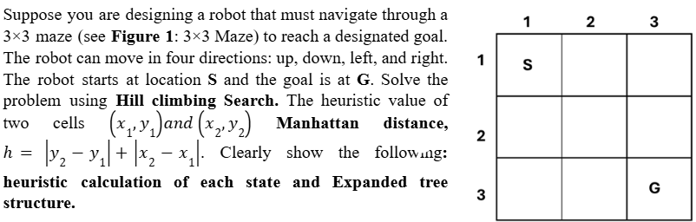
Example

Slide 25
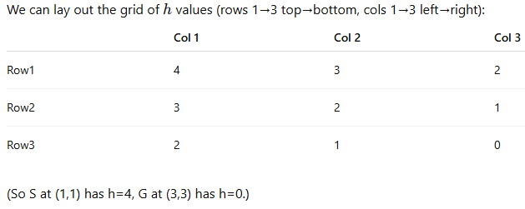
Example
Solution by Hill Climbing Search
Heuristic Calculation The heuristic h for any cell (r,c) to the goal (3,3) is the Manhattan distance: h=∣3−r∣+∣3−c∣
Calculations for relevant states:
Heuristic (Manhattan) for every cell — show the arithmetic
h(1,1)=∣3−1∣+∣3−1∣=2+2=4
h(1,2)=∣3−1∣+∣3−2∣=2+1=3
h(2,1)=∣3−2∣+∣3−1∣=1+2=3
h(2,2)=∣3−2∣+∣3−2∣=1+1=2
h(3,1)=∣3−3∣+∣3−1∣=0+2=2
h(3,2)=∣3−3∣+∣3−2∣=0+1=1
h(3,3)=∣3−3∣+∣3−3∣=0+0=0

Slide 26
Example
Expanded Tree Structure (Hill-climbing steps and tie-break)
Hill-climbing at each state inspects the neighbours (up/down/left/right) and moves to the neighbour with the lowest h. If there is a tie, hill-climbing needs a tie-break rule — here I’ll assume we pick the first best neighbour encountered in the order Right, Down, Left, Up (you can of course pick another tie rule; I’ll note alternatives later).
Start: (1,1), h=4. Neighbours:
Right (1,2): h=3
Down (2,1): h=3 Both equal (3). By our tie rule choose Right (1,2).
From (1,2), h=3. Neighbours:
Right (1,3): h=2 ← best
Down (2,2): h=2
Left (1,1): h=4 Pick (1,3) (first best).
From (1,3), h=2. Neighbours:
Down (2,3): h=1 ← best
Left (1,2): h=3 Pick (2,3).

Slide 27
Example
From (2,3), h=1. Neighbours:
Down (3,3): h=0 ← goal & best
Up (1,3): h=2
Left (2,2): h=2 Pick (3,3) → goal reached.
So the hill-climbing path (with chosen tie breaks) is:
(1,1) (h=4) → (1,2) (h=3) → (1,3) (h=2) → (2,3) (h=1) → (3,3) (h=0)

Slide 28
Example
Expanded tree structure (showing, at each expanded node, the neighbours inspected and their h)
Root: (1,1) h=4 ├─ (1,2) h=3 ← chosen └─ (2,1) h=3 (also inspected but not chosen)
Then expand (1,2) h=3: ├─ (1,3) h=2 ← chosen ├─ (2,2) h=2 (inspected, equal but not chosen) └─ (1,1) h=4 (back to parent)
Then expand (1,3) h=2: ├─ (2,3) h=1 ← chosen └─ (1,2) h=3
Then expand (2,3) h=1: ├─ (3,3) h=0 ← chosen (goal) ├─ (1,3) h=2 └─ (2,2) h=2
Finally (3,3) h=0 → goal, stop.

Slide 29
Example
What is the difference between Hill climbing search and Local Beam Search?
Differentiate between Classical Search and Local Search

Slide 30
Local beam search
Local Beam Search is a local search algorithm that keeps k best states (called beams) at each step, instead of just one state like hill climbing.
✔ Definition
Local Beam Search starts with k random initial states. At each iteration:
Generate all successors of the k states.
Evaluate all successors.
Select the k best successors.
These become the next beam of states.
This process continues until a goal is found or a stop condition occurs.
✔ Key Idea
Instead of climbing from one hill, LBS climbs from k hills simultaneously.If one path gets stuck, another may lead to the goal.

Slide 31
Local beam search
✔ Algorithm (Pseudo-code)
LocalBeamSearch(problem, k):
states ← k randomly generated states
loop until goal found:
successors ← all successors of all states
states ← k best successors from the list
✔ Example (Illustrative)
Suppose we choose beam width k = 3.
Initial beam:
State A: h = 7
State B: h = 5
State C: h = 6

Slide 32
Local beam search
Generate successors:
A1, A2, A3
B1, B2, B3
C1, C2, C3
Evaluate all 9 states.
Choose the best 3.
Those 3 become the next beam. Repeat until goal is found.
✔ Why is it better than simple Hill Climbing?
Hill Climbing:
Keeps only 1 current state → gets stuck easily.
Local Beam Search:
Keeps k states → less chance of getting stuck.
Information is shared among states.
Moves toward promising areas of the search space.

Slide 33
Local beam search
✔ Advantages
Better exploration than hill climbing.
Less chance of getting stuck in:
local maxima
plateaus
ridges
Uses multiple starting points.
✔ Disadvantages
Still possible to converge prematurely.
Requires choosing a good value of k.
More computation per step.

Slide 34
Classical Search and Local Search
Classical Search vs Local Search
1. Classical Search (Systematic Search)
Classical Search algorithms search systematically through a state space from an initial state until the goal is found.
✔ Characteristics
Starts from initial state, expands nodes using a frontier/queue.
Uses a path from start → goal.
Keeps memory of explored states.
Works well when:
State space is not too large.
Path to goal matters.
Typically guarantees finding a goal (often the optimal one, depending on the algorithm).

Slide 35
Classical Search and Local Search
✔ Examples
Breadth-First Search (BFS)
Depth-First Search (DFS)
Uniform Cost Search
A* Search
Greedy Best-First Search
✔ Advantages
Can guarantee:
Completeness (finds solution if one exists)
Optimality (e.g., BFS, UCS, A*)
Uses the transition model (actions and results).
✔ Disadvantages
Often uses high memory (must store frontier + explored list).
Can be slow for huge search spaces.

Slide 36
Classical Search and Local Search
Local Search
Local search algorithms search using a single current state, moving to a "neighbor" state. They do not track the path, only improve the current configuration.
✔ Characteristics
Uses one current node, not a frontier.
No memory of visited states (usually).
Designed for optimization problems.
Does NOT guarantee optimal solution.
Can get stuck in:
Local maxima
Plateaus
Ridges

Slide 37
Classical Search and Local Search
✔ Examples
Hill Climbing
Simulated Annealing
Genetic Algorithms
Local Beam Search
✔ Advantages
Uses very little memory.
Works well for large/infinite state spaces.
Useful when path is unimportant; only the final state matters (e.g., N-Queens).
✔ Disadvantages
Can get stuck; no guarantee of:
Completeness
Optimality

Slide 38
Classical Search and Local Search
Key Differences (Table)
Simple Example Comparison
Classical Search Example — BFS
Finds shortest path to goal.
Expands nodes level by level.
Works well when branching factor is small.
Local Search Example — Hill Climbing
Start at a state.
Move to neighbor with better heuristic value.
Can reach a global optimum or get stuck in local optimum.

Slide 39
Classical Search vs Local Search
Feature | Classical Search | Local Search
States stored | Many (frontier + explored) | One current state
Memory usage | High | Very low
Path to goal | Important & returned | Not important; usually not returned
Goal type | Find a goal state | Optimization (best state)
Guarantees | Often complete & optimal | Not complete, not optimal
Works best for | Small/medium state spaces | Very large/continuous spaces
Examples | BFS, DFS, A*, UCS | Hill Climbing, SA, GA

Slide 40
Hill climbing, Random walk and Simulated Annealing Search
Shortly discuss about Hill climbing, Random walk and Simulated Annealing Search?
Hill Climbing Search
Hill climbing is a local search algorithm that starts with an initial state and repeatedly moves to a neighboring state with a better heuristic value
It aims to improve the solution step by step until no better neighbor exists. Limitation: It can get stuck in local maxima, plateaus, or ridges, so it may fail to find the global optimum.
Random Walk
Random walk is a simple strategy where the algorithm moves to a random neighboring state, regardless of whether it improves the solution or not.
It helps in escaping local optima but is inefficient because it lacks direction and may take a long time to reach a good solution
Simulated Annealing Search
Simulated annealing is an improved hill-climbing method inspired by the annealing process in metallurgy
It sometimes accepts worse solutions with a probability that decreases over time (controlled by a temperature parameter).
This allows it to escape local maxima early and gradually converge to a near-optimal or global solution.

Slide 41
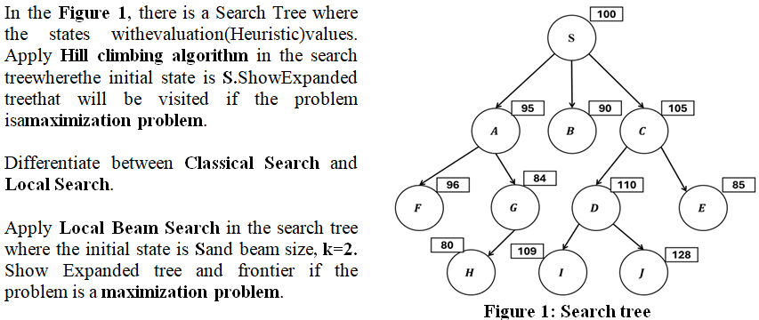
Example

Slide 42
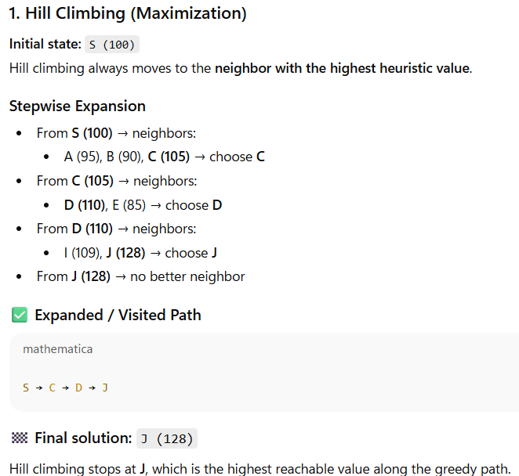
Solution

Slide 43
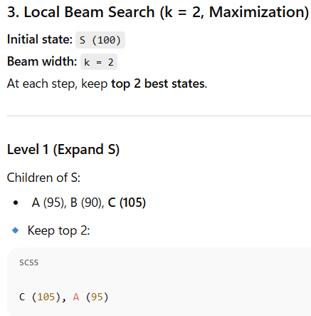
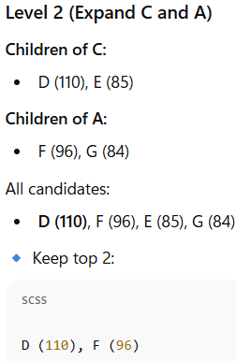
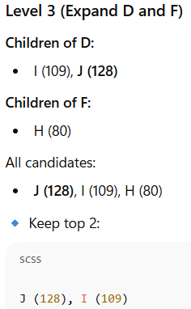
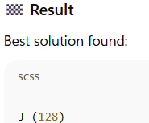
Solution

